Slide 1
K-Mart project Presentation Group 10 Ryan Gallagher Glen Bradford Balmatee Bidassie Emmanuel Jefferson Liang Zeng

Slide 2
Day 1: Significant Problems and potential improvements

Slide 3
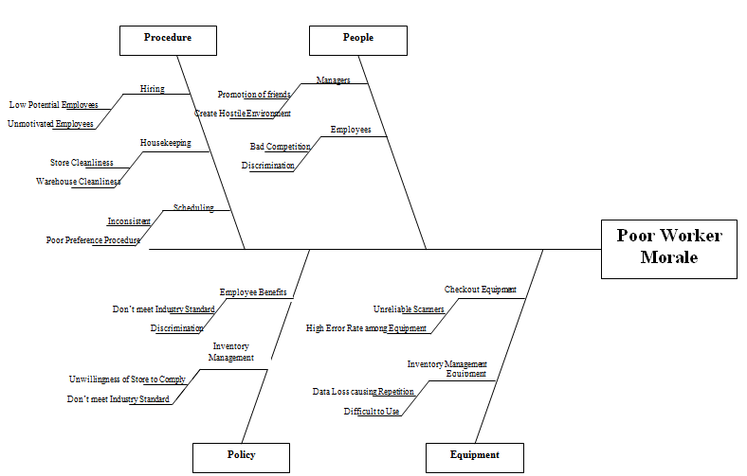
Day 1: Significant Problems

Slide 4
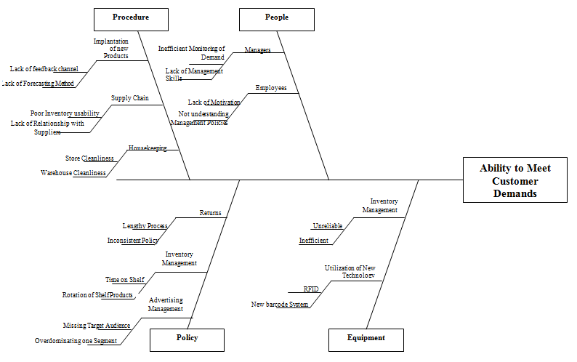
Day 1: Significant Problems

Slide 5
Day 1: Proposals for Improvement
Procedures
Established a standardize practices which include improving hiring process that utilizes behavior questions
Established a schedule for in store housekeeping and warehouse housekeeping. This will help the organization identify their inventory more accurately
Improved the communication and database relationship between suppliers and the company
People
Creating an environment where employees feel welcome
Includes the employees in the decision making process
Schedule a company sponsored activities such as picnics or sports event.
Don’t show favorites or discrimination among employees
Consistent scheduling

Slide 6
Day 1: Proposals for Improvement
Policy
Ensuring that the policy are accurately follow and consistent from case to case
Create a reward and punishment program
Compare the company policy with other companies
Making sure that the policy meeting with vision and mission of the company, so that the employees have a clear vision about the company
Being diverse and make sure that all the company market segment are hit.
Equipment
Making sure that the equipment will help the employees to work
Quick response to down equipment
Utilize New Technologies

Slide 7
Day 2: Vision Statement

Slide 8
Day 2: Vision Statement
Vision Statement “To become a global and inspiring leader in broad line retailing while pursuing total customer satisfaction, high employee morale, continuously achieving higher shareholder returns and strong community ties.”

Slide 9
Day 2: Strategic Objectives
Strategic Objectives
Position ourselves to have the largest market share in North America in the next 10 years
To reach 90% total customer satisfaction in the next 5 years
Achieve employee turnover rate under 5% in the next 10 years
Double the shareholder returns in the next 5 years
To be the major philanthropic contributor among other large scale corporations in 5 years

Slide 10
Day 2: Vision Statement
Operational Goals
Increase the market share by 10% each year, by opening more stores and expanding into high population areas.
Decrease the complaints rate by 50% in one year.
Decrease the resign rate by 20% in one year.
Increase the shareholder return by 30% in next year.
To be the top contributor in a major philanthropic event every year.
To achieve no recorded injury in our daily processes.

Slide 11
Day 3: Quality Function Deployment (QFD)

Slide 12
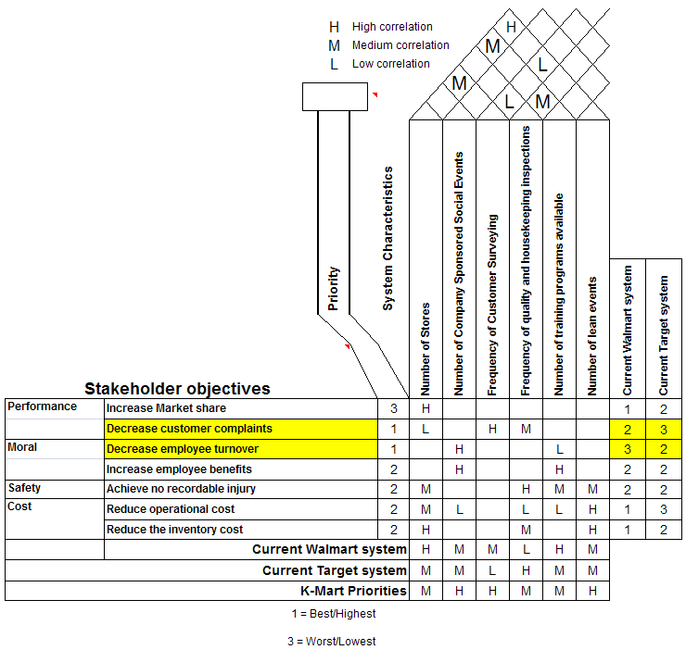
Day 3: Quality Function Deployment (QFD)

Slide 13
Day 3: Quality Function Deployment (QFD)
Indentified Market Opportunities:
Decrease customer complaints
Decrease employee turnover
Identified Problems:
No problems with House of Quality. Not many blank cells. A single objective is not correlated with too many system characteristics and vice-versa.

Slide 14
Day 3: Quality Function Deployment (QFD)
Target Values and Priorities for system characteristics:
Number of Company sponsored social events
Frequency of Customer Surveying
Number of Lean Event

Slide 15
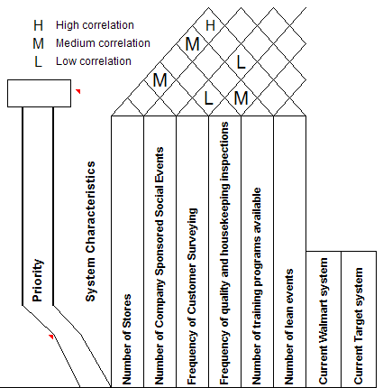
Day 3: Quality Function Deployment (QFD)
Inter-correlations between system characteristics:
Number of stores is highly correlated with the number of lean events

Slide 16
Day 4: Lean Initiatives

Slide 17
Day 4: Lean Initiatives
Lean Processes K-Mart can apply:
Pull system in terms of inventory and supply chain
Total Quality Control
Work Cell Designs
Continuous Reduction of Wastes
Continuous Improvement

Slide 18
Day 4: Lean Initiatives
Advantages:
Reduced lead time
Reduced excess inventory
Reduced Transportation Cost
Disadvantages:
Cost
Final Goal
Existing Knowledge
Sensitivity of lean system

Slide 19
Day 5: Experimental Design

Slide 20
Day 5: Experiment Design
Objective: to improve customer satisfaction by reduce average waiting time in queue.
20% of reduction in customer waiting time to be of practical significance.
Experiment design: one-factor factorial design (balanced).
Dependent variable: waiting time of each customer.
Independent variable: the number of queue lines for the checkout area (single vs. multiple).

Slide 21
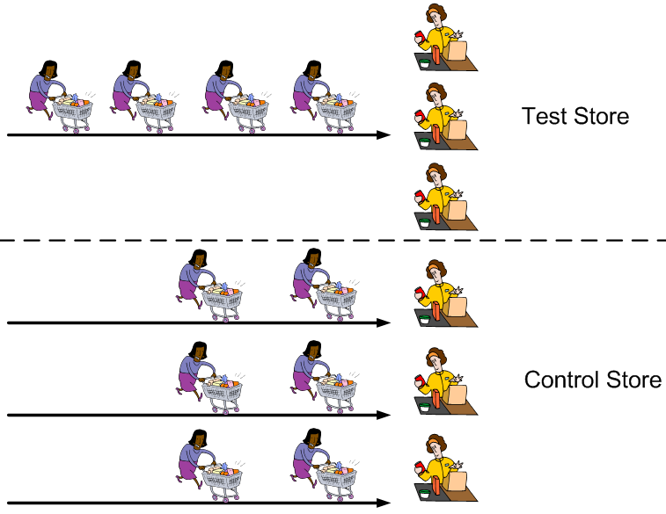
Day 5: Experiment Design

Slide 22
Day 5: Experiment Design
Experiment control
the quality and skill level of registers;
number of counters (5);
the location of counters;
the time of conducting the experiment;
the number of customers in the store.
One-way ANOVA analysis: F_{1,58}=6.71, P=0.0121, reduction of waiting time: 38%.
The use of a single-queue multiple-server system is recommended.

